Slide 1
Rubik’s Cube

Slide 2
Basic Idea
Cube is made of center/edge/corner piece
Solving means moving all pieces in right position & direction
Reading all states of takes too much time ->Copy first state of cube into computer and solve it

Slide 3
Types of Piece in Cube
Center Piece : Has only one side, 6 pcs in a 3x3 cube
Edge Piece : Has two sides, 12 pcs in a 3x3 cube
Corner Piece : Has three sides, 8 pcs in a 3x3 cube
Each piece has position & direction

Slide 4
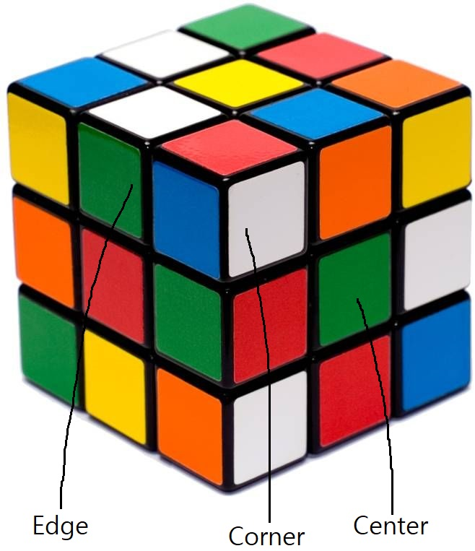
s

Slide 5
Building Virtual Cube
Center Piece : No need to make(doesn’t move)
Edge Piece : has own ID and two sides
Corner Piece : has own ID and three sides
Each side has four edge/corner piece that has its color

Slide 6
Making Virtual Cube
Rotating a side means moving certain four edge/corner piece
Moving pieces = changing position & direction of pieces
Six sides, two ways to rotate(clockwise, anti-clockwise)

Slide 7
Copying Cube into Computer
Each piece is distinguished by combination of color
If two cube has same color combination, it means that they have same state
Copying color combination of cube can make virtual cube

Slide 8
Solving Cube
Solving has a certain process : need to “Divide and Conquer”
This code solves cube layer-based idea
Many algorithm exist, but most of them share this idea

Slide 9
Solving Cube
Solving cube is a set of rotation ->doing same set of rotation will solve real cube
This code records every rotation that has done and prints it
A few unnecessary rotation will be deleted for efficiency

